Slide 1
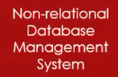

NoSQL (Not Only SQL) Database

Slide 2










NoSQL (Not Only SQL) Database

Slide 3
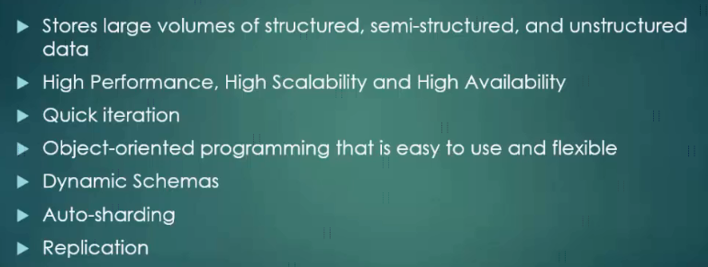
NoSQL (Not Only SQL) Database

Slide 4
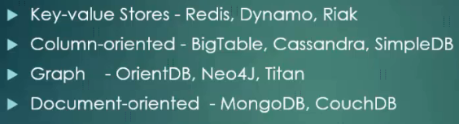
NoSQL (Not Only SQL) Database

